Slide 1
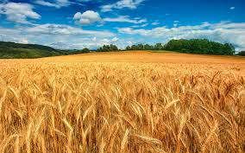
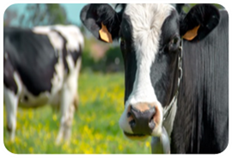
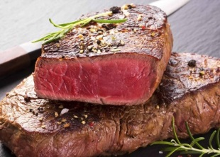
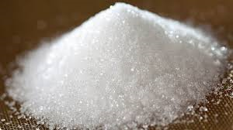
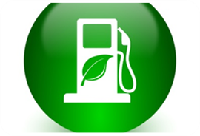
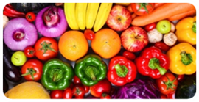
Modelling Agricultural and rural policies in the JRC and DG-AGRI
BESTMAP Online Workshop
Tuesday 14th July 2020
Ignacio Pérez Domínguez
Joint Research Centre, Directorate D Sustainable Resources
Unit D4 Economics of Agriculture

Slide 2
Outline
Introduction: past, present and future
Agricultural policy modelling at the JRC: relevant (recent) examples:
  Short to Medium-Term: EU Agricultural Outlook 2019-2030
  Medium-Term: CAP Contribution to 2030 Climate Targets
  Long-Term: Climate Change Adaptation by 2050
Some reflections: the role of BESTMAP

Slide 3
Introduction: past, present and future
PAST: OUTSOURCING
Collaborations with Universities and Research Institutions
PRESENT:
INHOUSE MODEL PLATFORM (iMAP)
FUTURE:
FOCUS ON RESULTS
New indicators some of which are not provided by current models
World
EU
MS
Region
Farm
Grid level
AGLINK-COSIMO
MAGNET
All economy,
all policies,
SDGs
Base
line
Baseline
AGMEMOD
EU MS
CAPRI
CAP in detail
NUTS 2
Baseline
Improve existing and create new
links to biophysical models both
within JRC and outside
IFM-CAP
Farm level

Slide 4
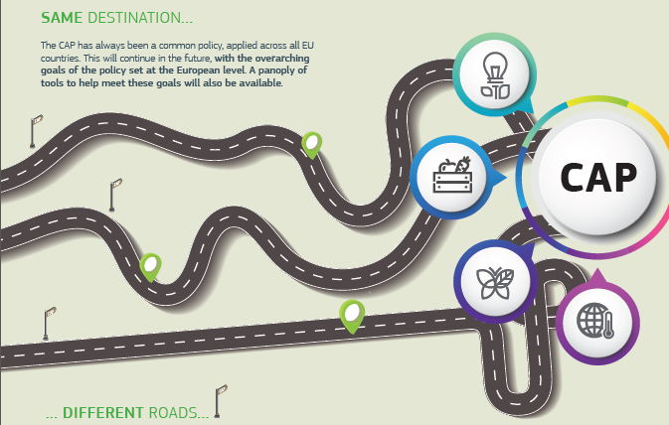
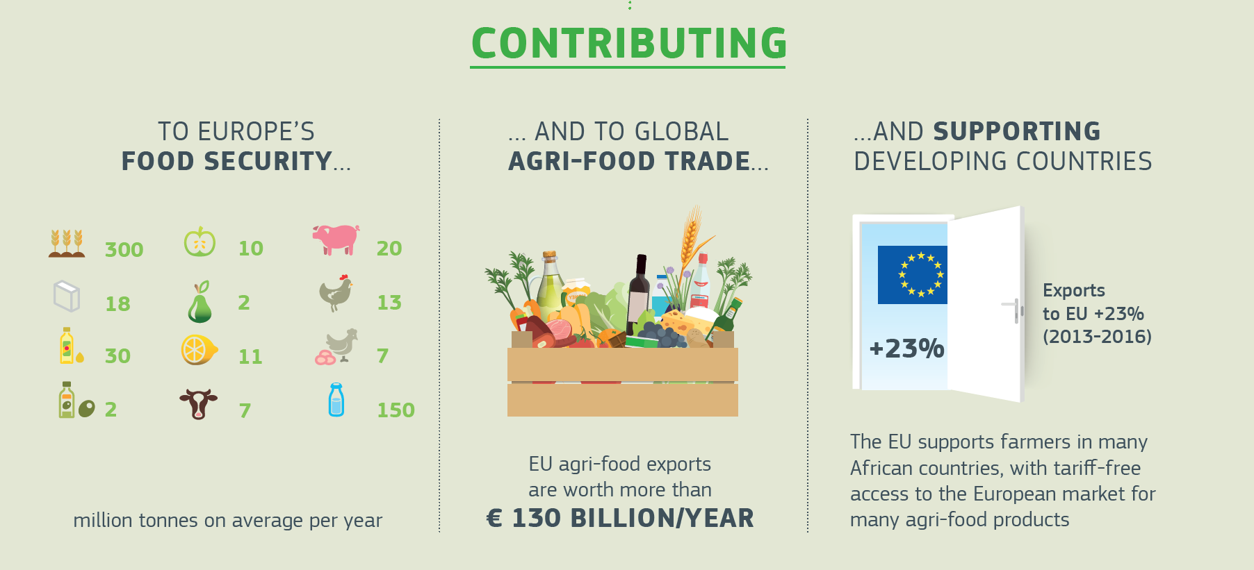
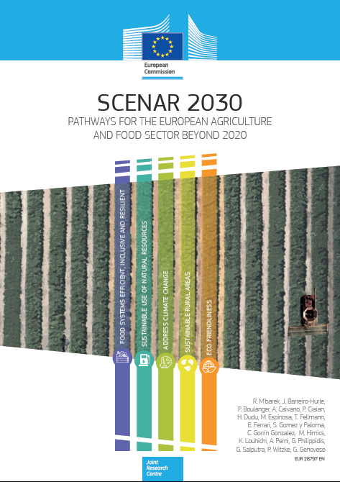

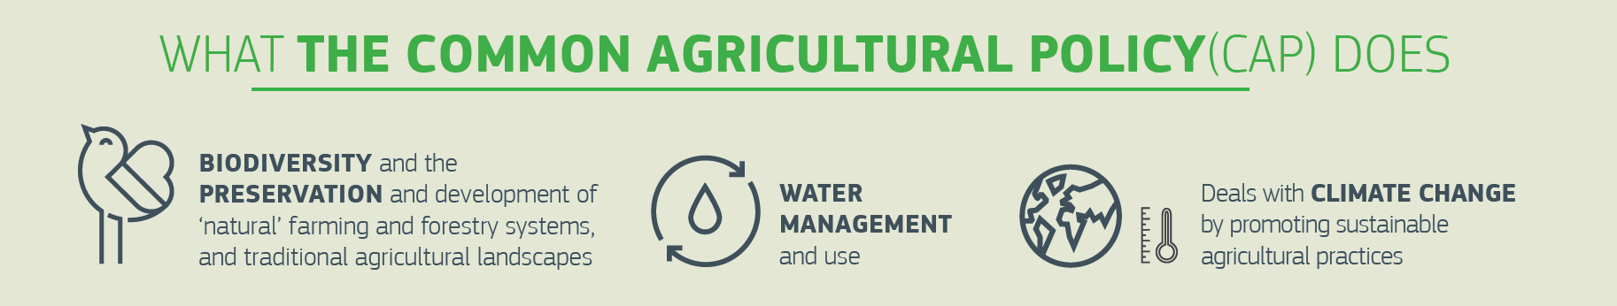
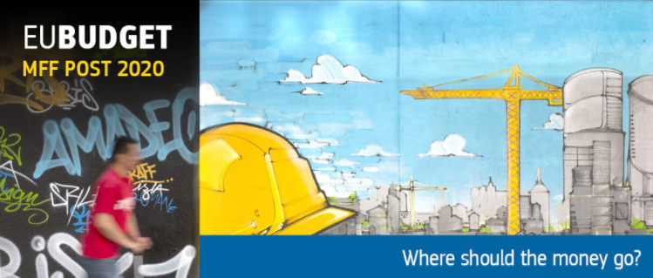





From modelling policy anticipation to policy support
2016
2017
2018
2020

Slide 5
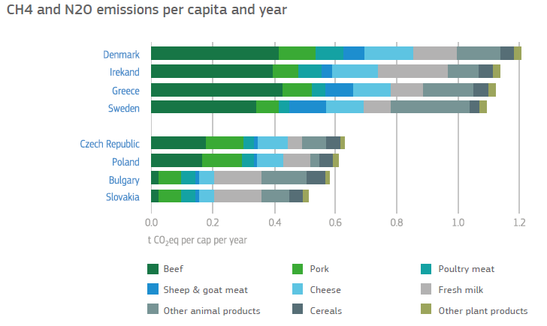
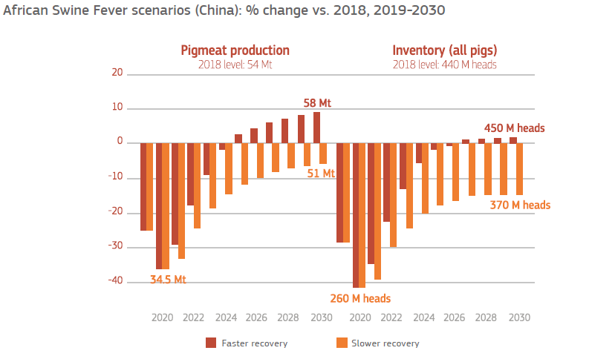
Short to Medium Term: EU Outlook

Slide 6
Medium Term: CAP contribution to 2030 Climate Targets
Model results for 2030:
Baseline
CAP LP 4 Climate
CAP LP 4 Climate + NGEU
Land use
CAP LP texts
Supply
Assumptions for CAPRI model
F2F and BD strategies
Trade flows
Latest MFF figures
Prices, revenues and costs
GHG and GNB
Technology adoption shares
DG AGRI + DG JRC
DG JRC
Leakage

Slide 7
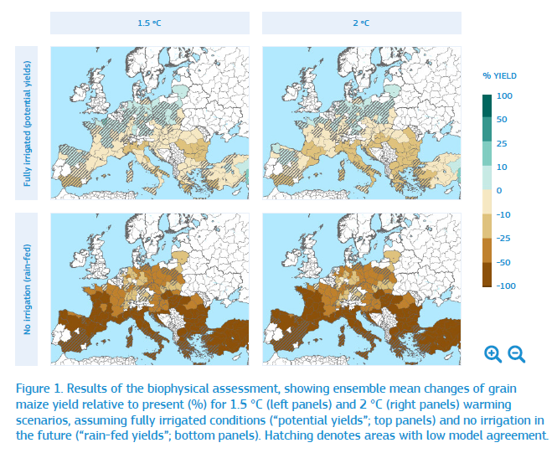
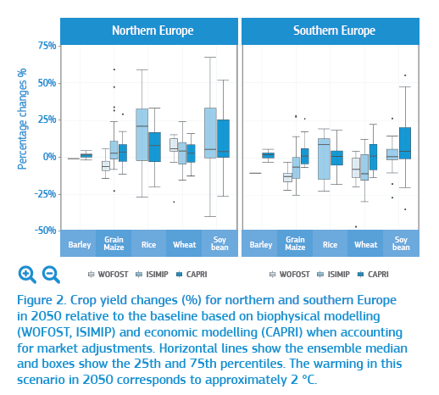
Long-Term: Climate Change Adaptation (PESETA IV)

Slide 8
Some reflections: the role of BESTMAP
Provide an additional layer of results/indicators to existing models
Work at pan-European level (importance of extrapolating and upscaling information)
Provide validation of results is key, good governance of newly developed model tools and “measure the model links” (look at reflections by SUPREMA)
Rely on existing data sets and do not underestimate the costs of maintenance/update
NextGen models should have a stronger bottom-up component (high resolution), make use of AI tools (i.e. machine learning, machine reasoning), rely on 'big (unstructured) data', remain open-source and be accessible online

Slide 9
THANK YOU !
ignacio.perez-dominguez@ec.europa.eu

