Slide 1

BestMap Stakeholders Meeting
15/07/2020
Carlos Leyva, IDENER

Slide 2
AGRICORE at a glance
Underlying concept
Main figures and outcomes
Use cases
AGRIMODELS cluster

Slide 3
AGRICORE at a glance

Slide 4
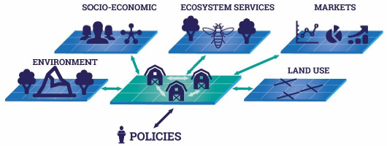
AGRICORE at a glance
The AGRICORE tool will be built as an agent-based approach where each farm is to be modelled as an autonomous decision-making entity which individually assesses its own context and makes decisions on the basis of its current situation and expectations. This modelling approach will allow to simulate the interaction between farms and their context (which will account for environment, rural integration, ecosystem services, land use and markets) at various geographic scales – from regional to global.

Slide 5
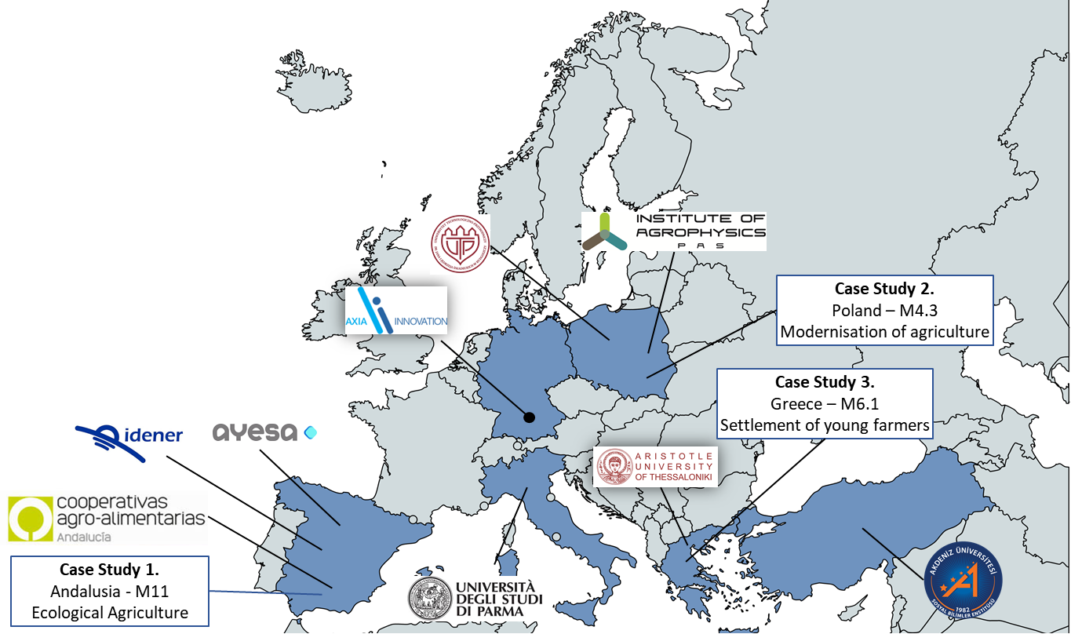





AGRICORE at a glance
PARTNERS
USE CASES
M11 – Ecological Agriculture
M10.1 Agri-environment-Climate Commitments
M6.1 – Settlement of Young Farmers

Slide 6
Underlying concept

Slide 7
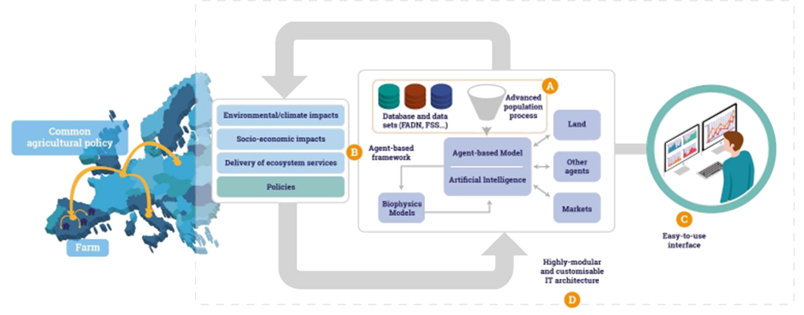
Underlying concept
Advanced population concept
Agent-based model
A user friendly
interface
Highly modular &
customisable architecture.
A
B
C
D

Slide 8
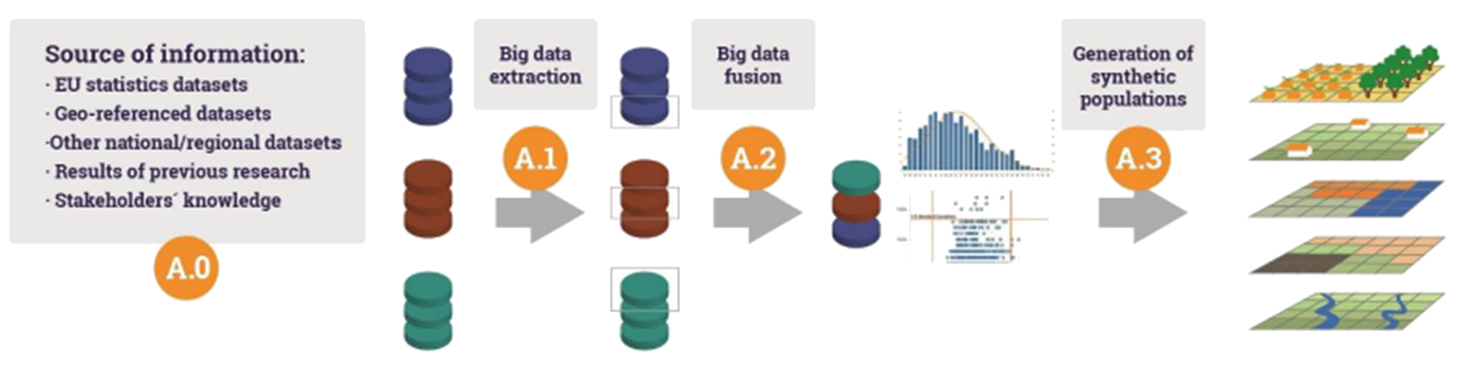
Underlying concept
Advanced population concept
Agent-based model
A user friendly
interface
Highly modular &
customisable architecture.
A
B
C
D

Slide 9
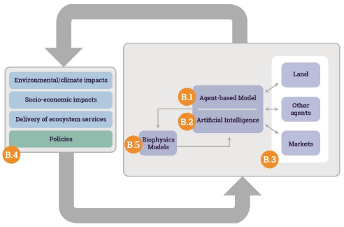
Underlying concept
B.1. Non-linear dynamic model of the fatm agents
B.2. AI-based farmer’s behavioural foundation
B.3. Model interactions
B.4. Context relationships
B.5. Links with biophysical models
Advanced population concept
Agent-based model
A user friendly
interface
Highly modular &
customisable architecture.
A
B
C
D

Slide 10
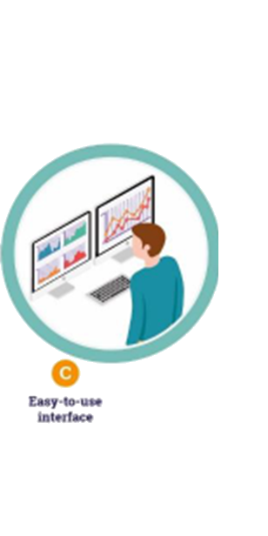
Underlying concept
Maps representation
Desktop application
Big-data analytics representation
Web technologies
Cross-platform
Advanced population concept
Agent-based model
A user friendly
interface
Highly modular &
customisable architecture.
A
B
C
D

Slide 11
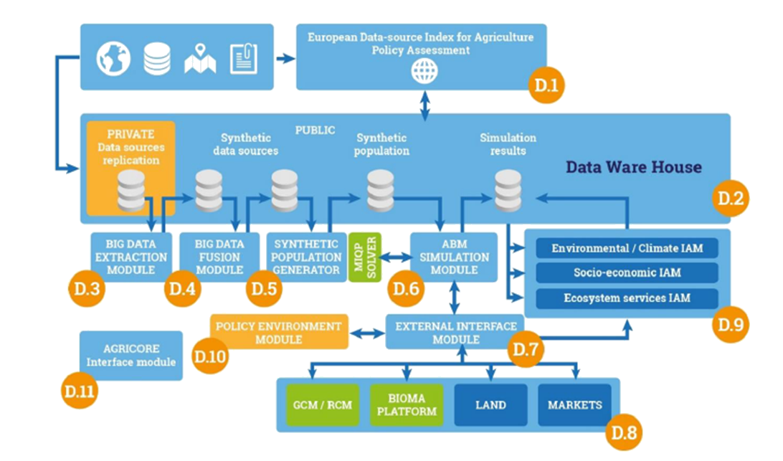
Underlying concept
Advanced population concept
Agent-based model
A user friendly
interface
Highly modular &
customisable architecture.
A
B
C
D

Slide 12
Main figures and outcomes

Slide 13
Main figures and outcomes
11 WPs
5
R&D
1
Integration
1
Demonstration
2
Comm. & Dissm.
2
Management
& Ethics
10 Partners
6 countries
4
Univ.
1
RTO
1
Large
1
SME
1
Assoc.
685 PM – 48 Months
42 Months
Research & Development
6 Months
Demonstrations
71 Deliverables
49 Public
12 Confidential

Slide 14
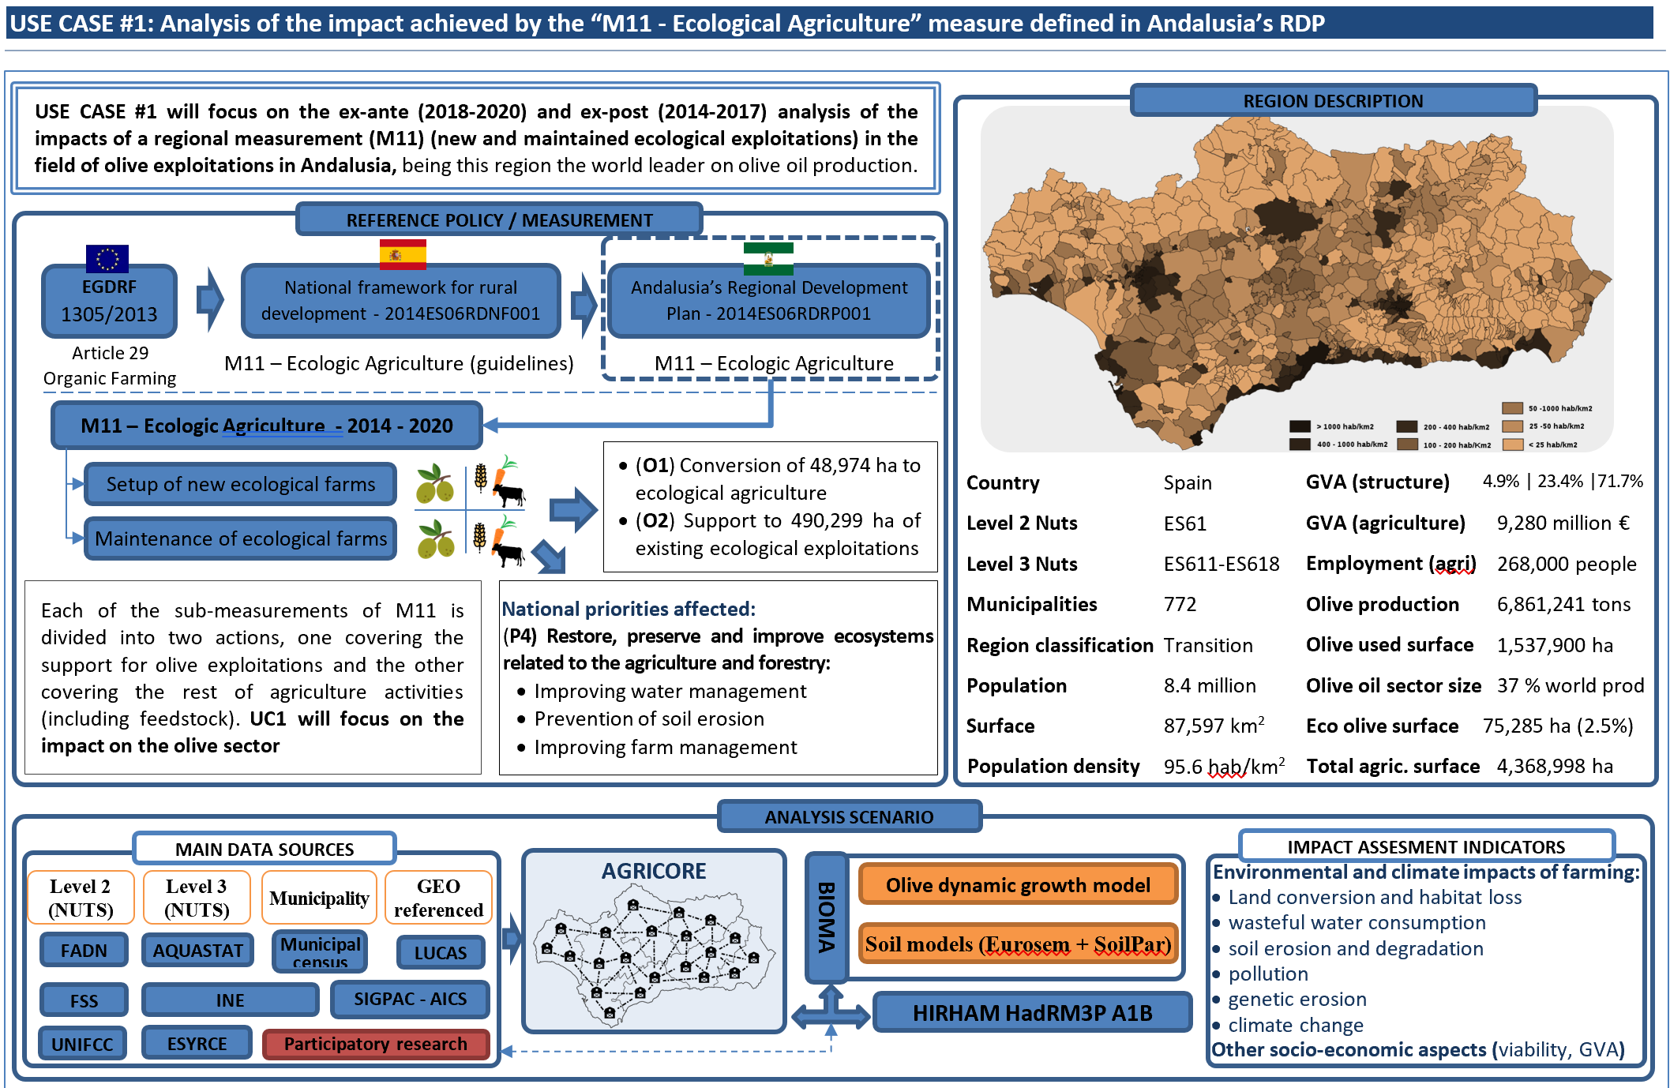
UC#1 - Spain

Slide 15
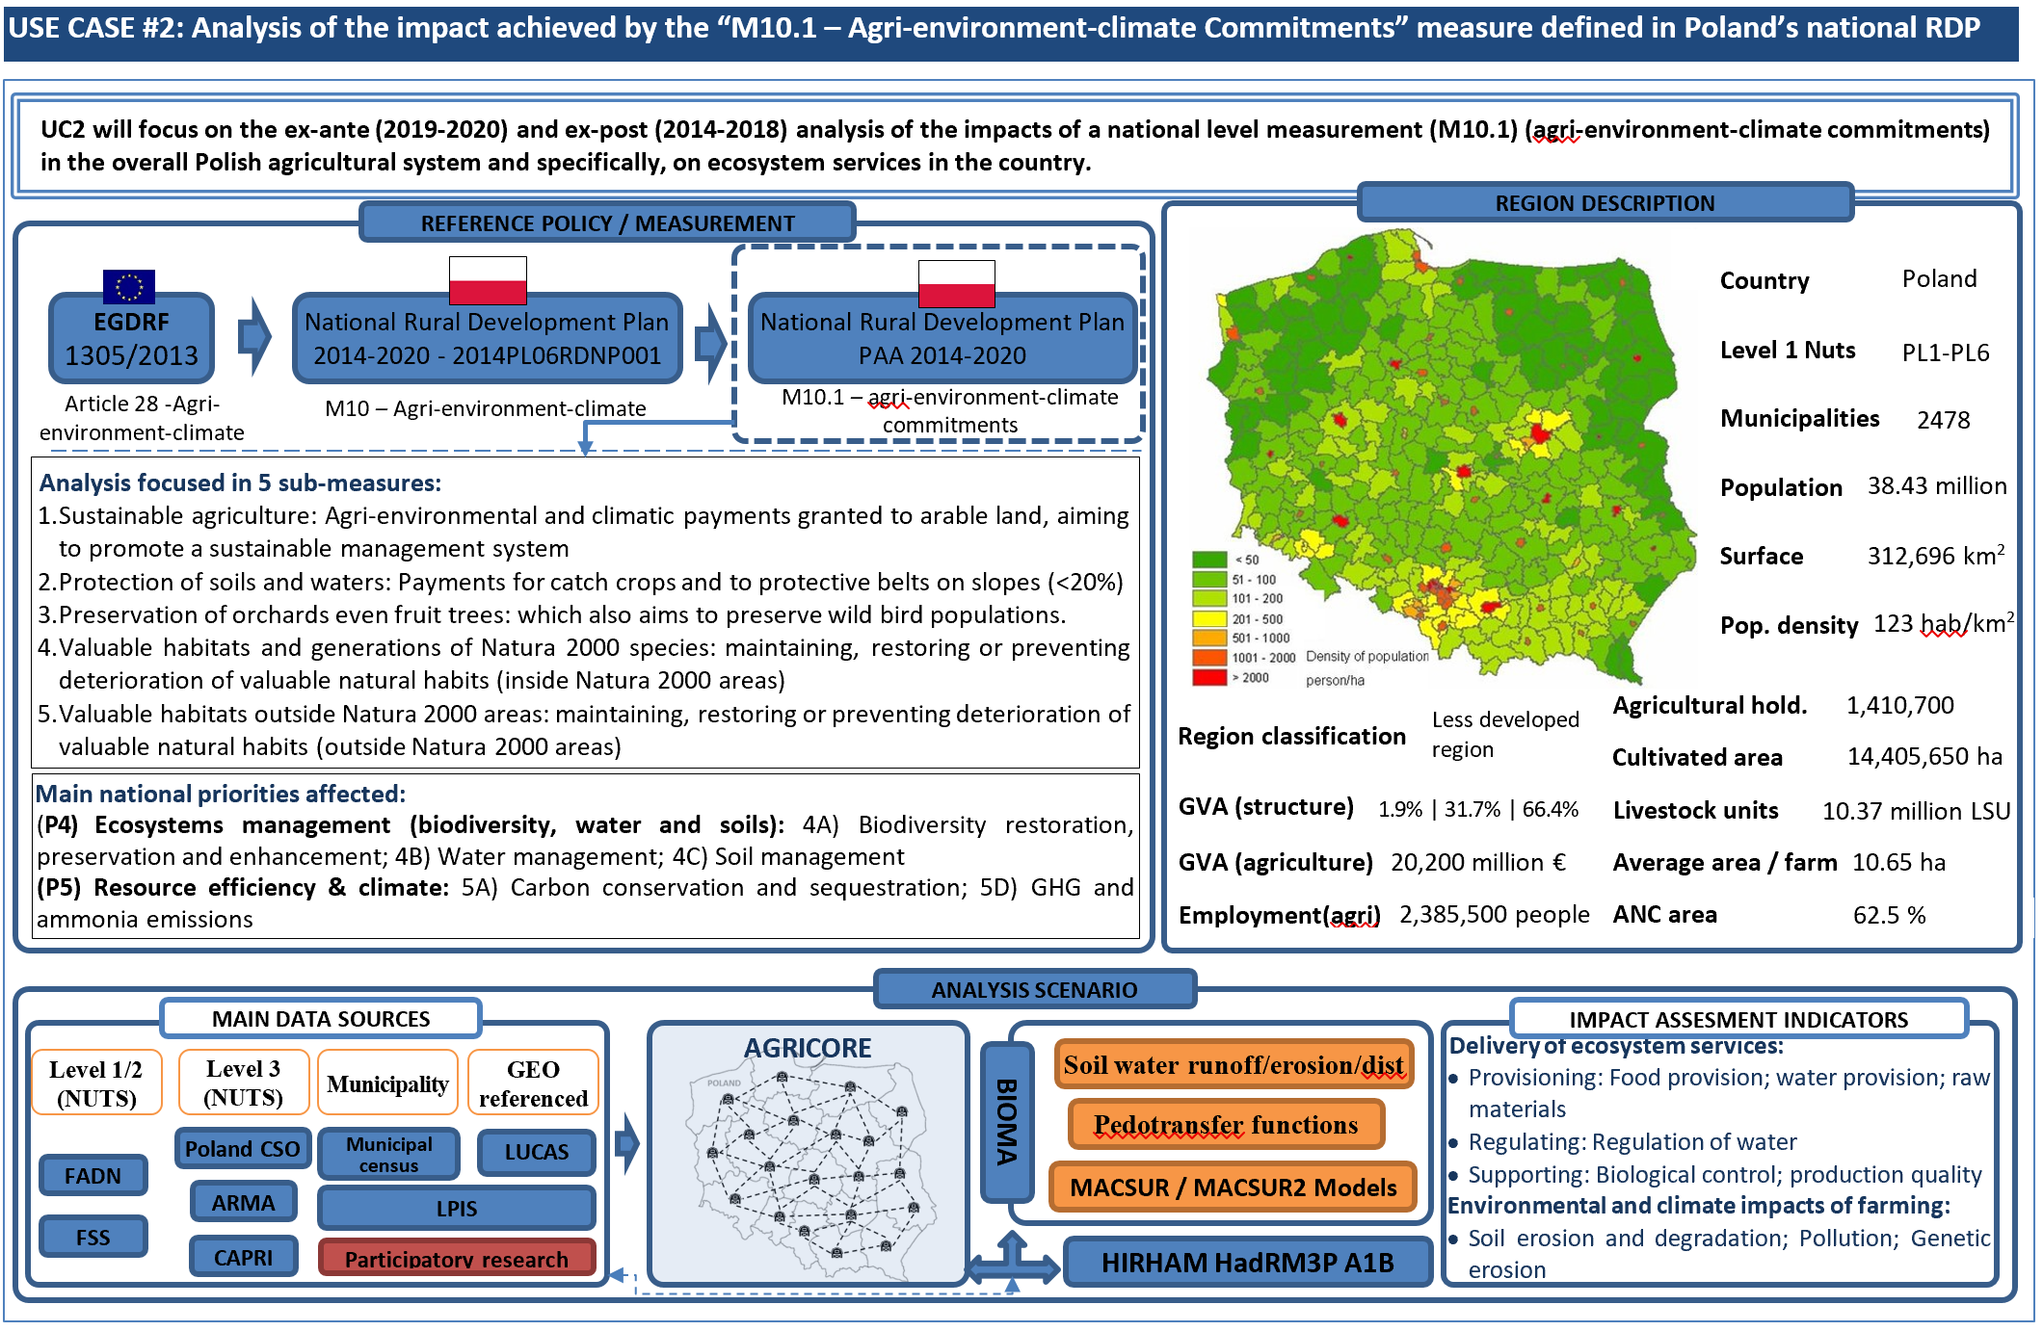
UC#2 - Poland

Slide 16
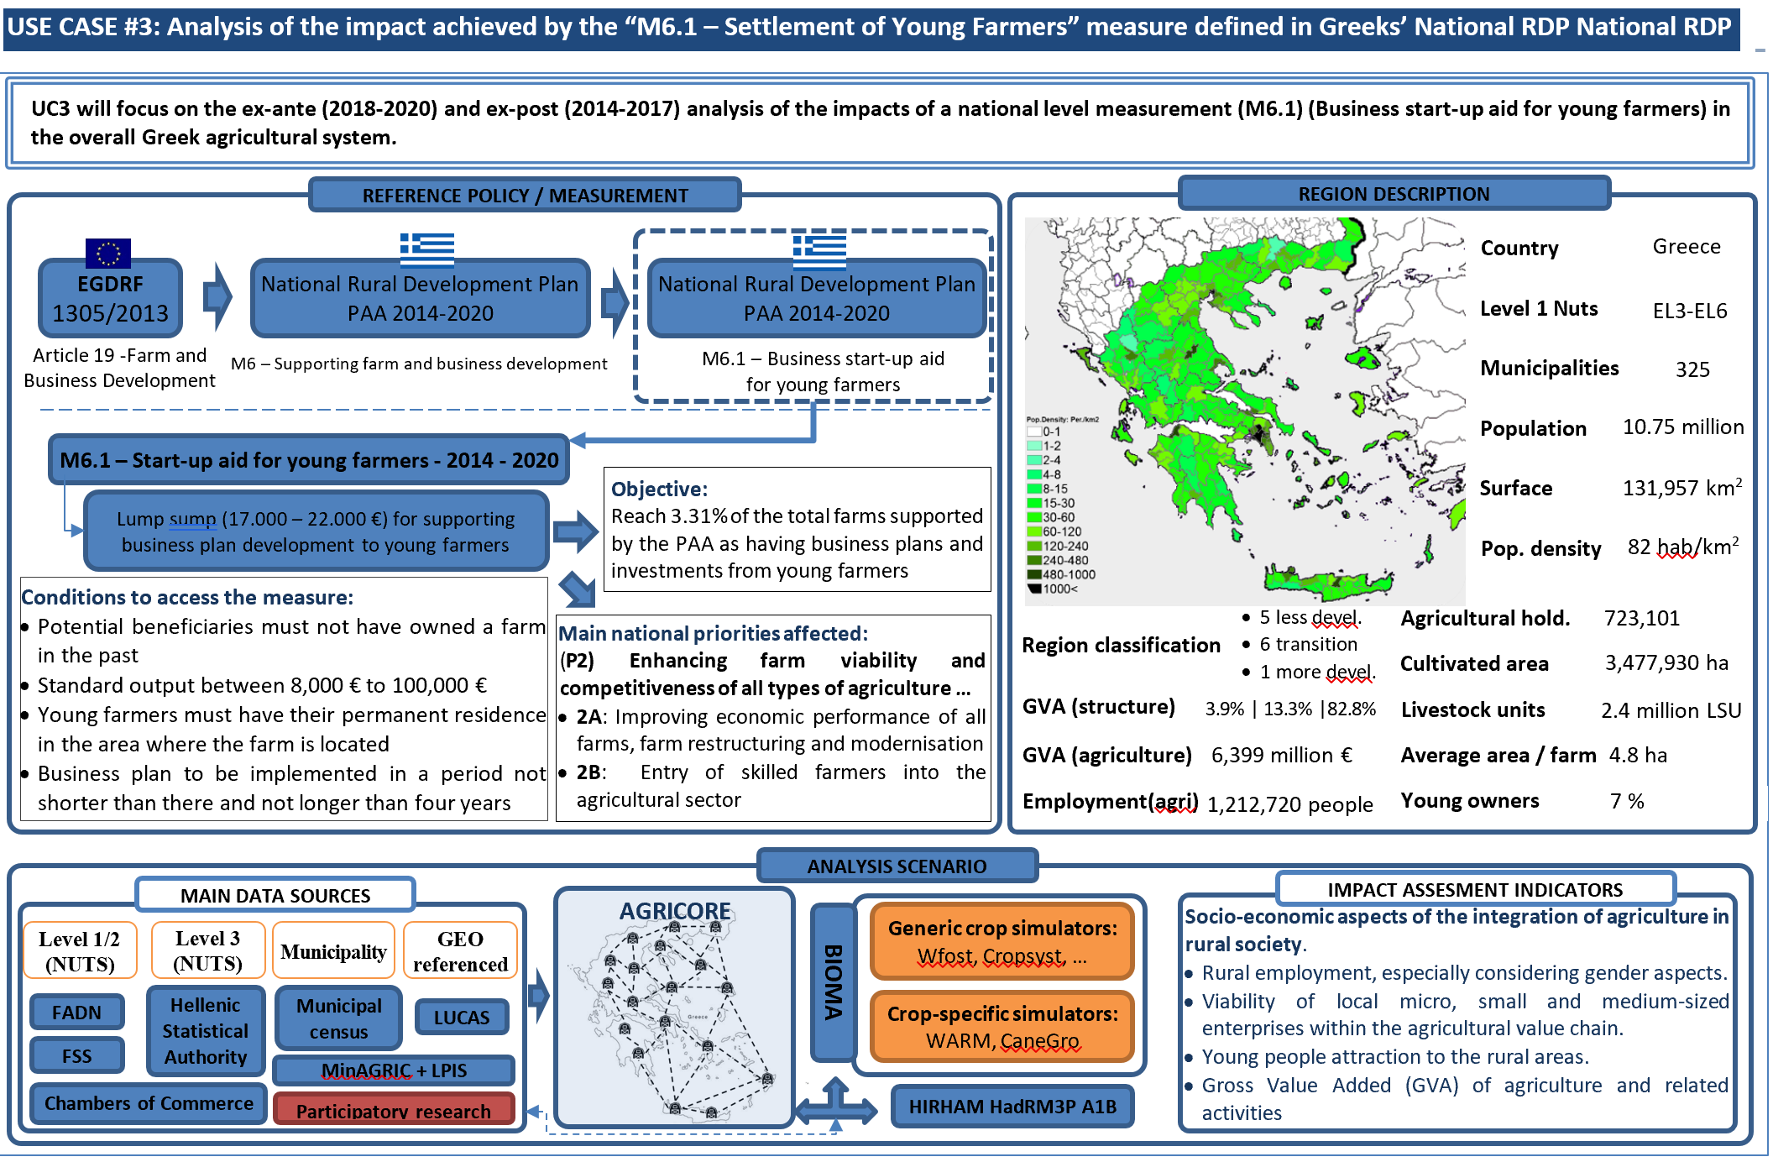
UC#3 - Greece

Slide 17
AGRIMODELS Cluster

Slide 18




AGRIMODELS cluster
https://agrimodels-cluster.eu/
Explore the use of ABM for policy assessment
Develop new tools to be integrated in the DG-AGRI / JRC modelling an IA processes
Share data acquisition and generation, research approaches and results to collaboratively improve IA capabilities at the EC.
Ensure continuity of the developments done within the project
AGRIMODELS
Cluster

Slide 19
Carlos Leyva
IDENER
Carlos.leyva@idener.es

