Slide 1
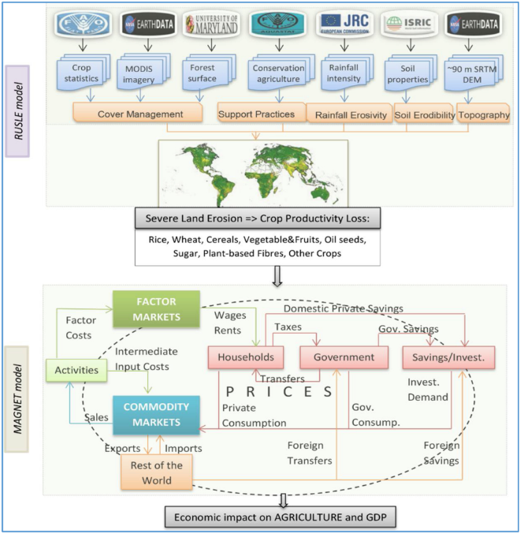
Following Panagos et al 2018, assume land with
>11 t/ha/yr of soil erosion has 8% productivity
reduction, otherwise no change in productivity
(in this paper, assumed reduction already in
GTAP equilibrium which MAGNET was calibrated
to reach, so increase 8% to get counter-factual)
This paper does not consider change of cropping area
or crop rotations/data on RUSLE C-factor, nor
any changes in adoption of no-till/low or cover crops
which impacts management P-factor
Does not consider that some sediments are locally
retained – sediment delivery ratio = ecosystem service
Sartori, M., Philippidis, G., Ferrari, E., Borrelli, P., Lugato, E., Montanarella, L., & Panagos, P. (2019). A linkage between the biophysical and the economic: Assessing the global market impacts of soil erosion. Land Use Policy, 86, 299–312. https://doi.org/10.1016/j.landusepol.2019.05.014

Slide 2
Estimates water quantity demand from agriculture
Does not consider that some nitrogen leaching is locally
retained – nutrient delivery ratio = ecosystem service
If N in water ↗, cost of treated water ↗ but
CAPRI only has agricultural economic sectors
so that feedback can’t be included
11,063 combinations of crops and environmental conditions
CAPRI
X8 scenarios fertilization, irrigation
180,000 Homogenous Spatial Mapping Units (HSMUs) on 1km2 grid
-nitrogen leaching
-nitrogen release during mineralization of organic matter
-nitrogen uptake of the crop
-gas losses as N2,N2O, NO and NH3
-total nitrification plus denitrification gas losses (N2 +N2O + NO)
-total nitrogen losses, water uptake by the crop
-water leached
-water evaporated
-water transpired
DNDC
Site-specific calibration (ensure consistency)
198 regression models
Britz, W., & Leip, A. (2009). Development of marginal emission factors for N losses from agricultural soils with the DNDC-CAPRI meta-model. Agriculture, Ecosystems and Environment, 133(3–4), 267–279. https://doi.org/10.1016/j.agee.2009.04.026

Slide 3
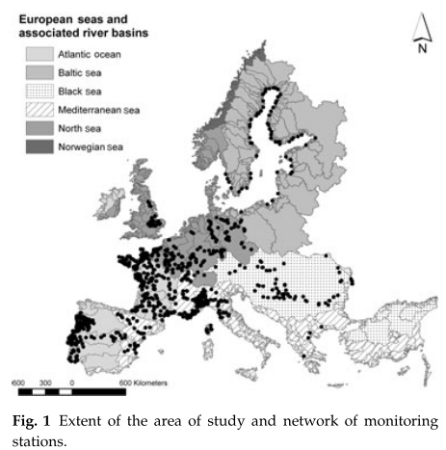
L_{i}=(DS_{i}*(1-BR_{i})+PS_{i}+U_{i})*(1-RR_{i})
DS_{i} (ton N/yr or P/yr) is the sum of diffuse sources
PS_{i} (ton N/yr or P/yr) is the sum of point sources
U_{i} (ton N/yr or P/yr) is the nutrient load received
from upstream sub-catchments
BR_{i} and RR_{i} (fraction, dimensionless) are the
estimated nutrient Basin Retention and
River Retention
BR_{i}=exp (-α_{P} * X_{P,i})
RR_{i}= exp (-α_{L} * X_{L,i})
X_{P,i} and X_{L,i} are the inverse of rainfall and the
river length
α_{P} and α_{L} were calibrated globally, and then
adjusted for 4 sub-regions
GREEN model uses
1985-2005 measured data
in 766 stations
(43256 stations in new
Waterbase w/ 1960-2018 data)
Ignores nutrient retention on
land = ecosystem service
DS_{i}
Grizzetti, B., Bouraoui, F., & Aloe, A. (2012). Changes of nitrogen and phosphorus loads to European seas. Global Change Biology, 18(2), 769–782. https://doi.org/10.1111/j.1365-2486.2011.02576.x
(i) the spatial information on areas occupied by agriculture and pasture was taken from the HYDE 3 database (Klein Gold- ewijk & Van Drecht, 2006), (ii) the geographical location of urban and water cover types was based on the GLC2000 (Bar- tholome´ & Belward, 2005), and (iii) the information on crop shares, crop types and fertilizer application rates was derived from the CAPRI database (Britz, 2004) for EU27, Norway and Balkan region, and from the FAO database (FAO, 2009) for the rest of Europe

Slide 4
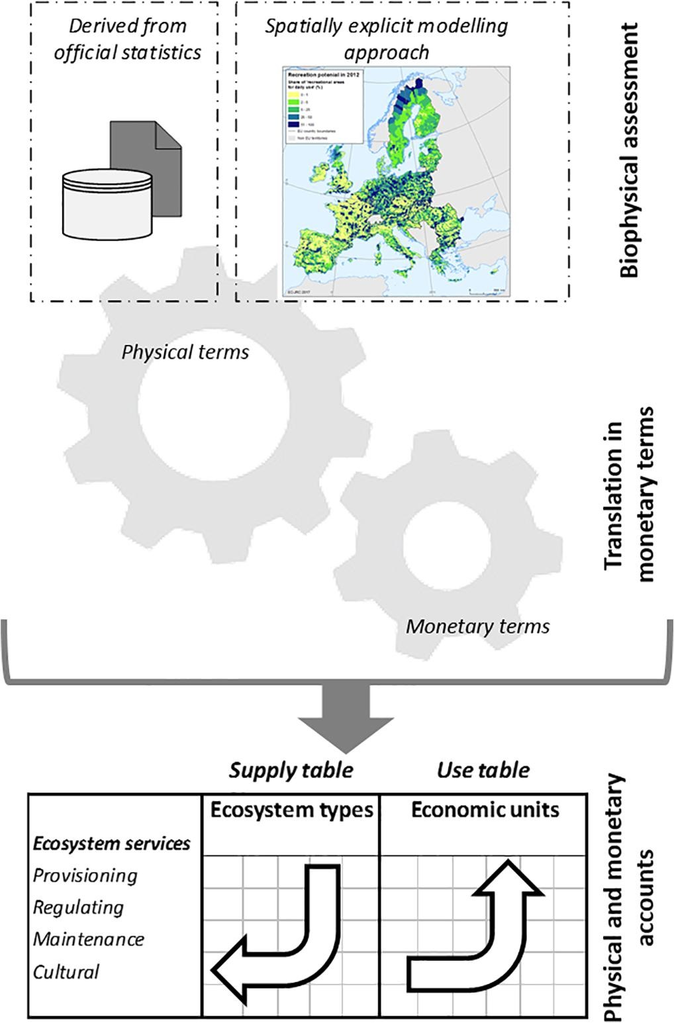
KIP-INCA
The KIP INCA framework for ES accounts follows three main steps
biophysical assessment of the ecosystem service
2) translation into monetary terms
3) compilation of supply and use tables This framework is consistent with the accounting structure of the SNA and SEEA EEA

Slide 5
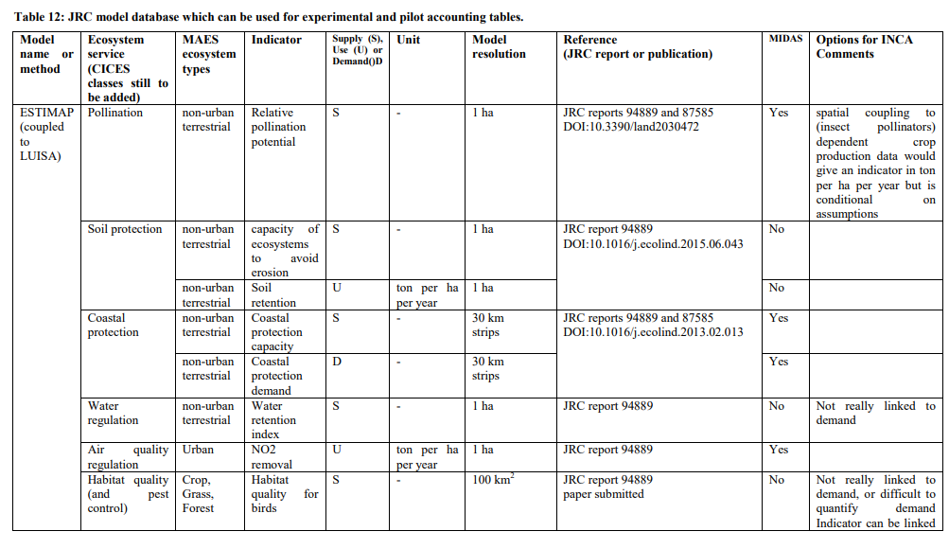
https://ec.europa.eu/environment/nature/capital_accounting/pdf/KIP_INCA_final_report_phase-1.pdf

Slide 6
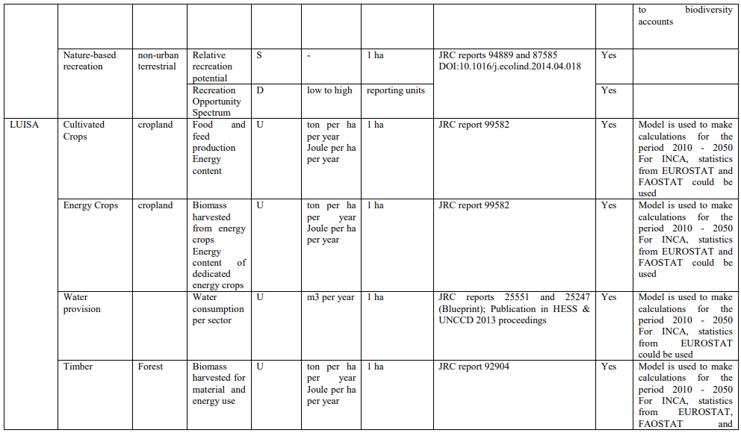

Slide 7
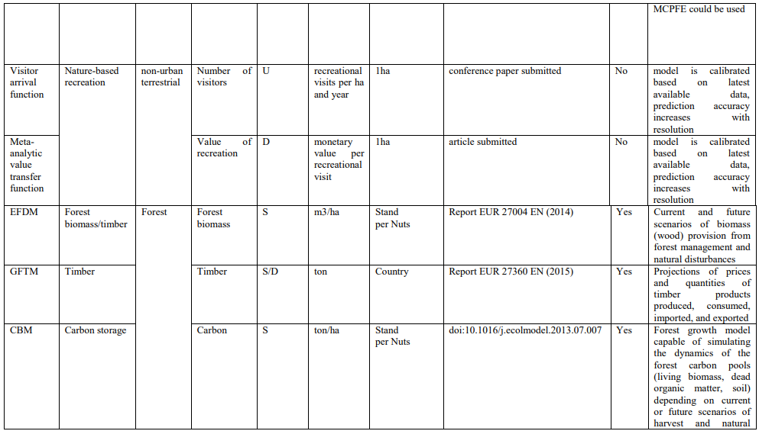

Slide 8
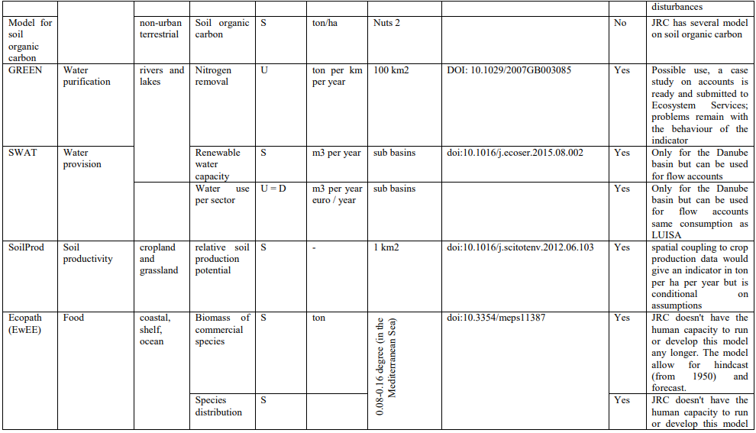

Slide 9
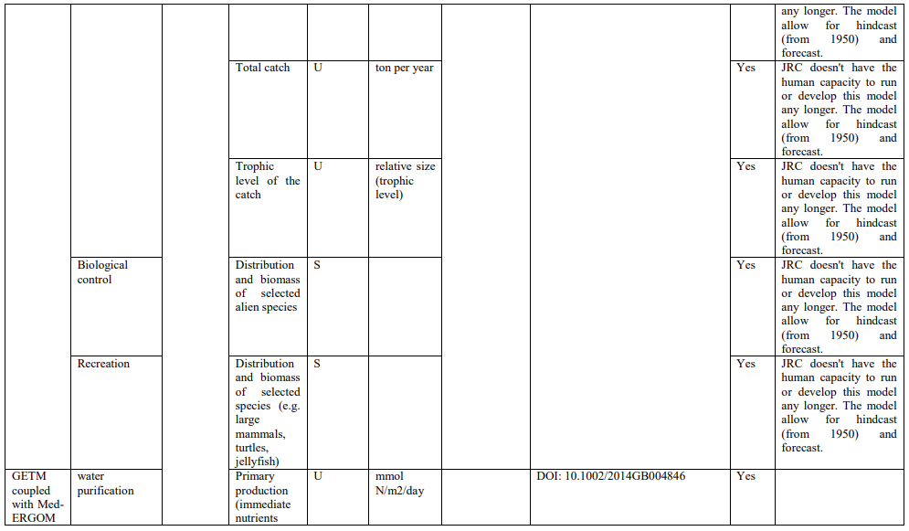

Slide 10
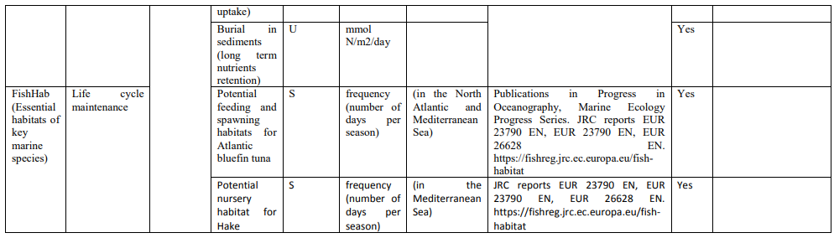

Slide 11
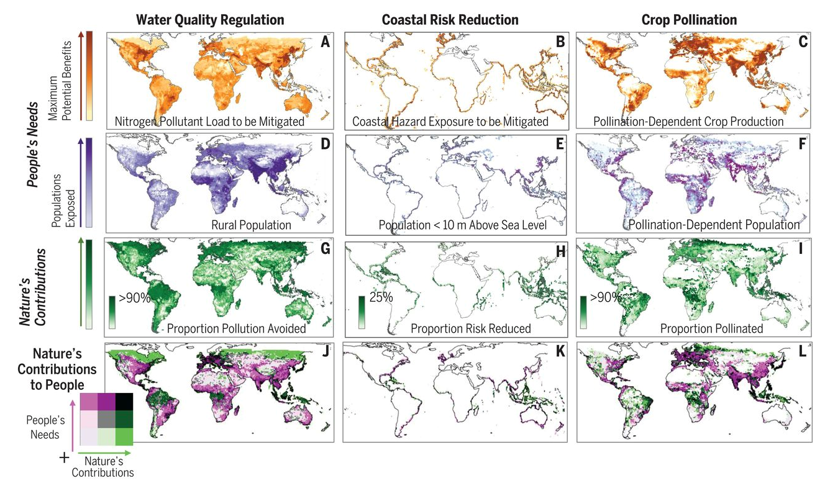
Chaplin-Kramer, R., Sharp, R. P., Weil, C., Bennett, E. M., Pascual, U., Arkema, K. K., Brauman, K. A., Bryant, B. P., Guerry, A. D., Haddad, N. M., Hamann, M., Hamel, P., Johnson, J. A., Mandle, L., Pereira, H. M., Polasky, S., Ruckelshaus, M., Shaw, M. R., Silver, J. M., … Daily, G. C. (2019). Global modeling of nature’s contributions to people. Science, 366(6462), 255–258. https://doi.org/10.1126/science.aaw3372

